Slide 1
Linq – language integrated query
easy data access from in-memory objects, databases, XML documents and many more
providing a single querying interface for different types of data sources.

Slide 2
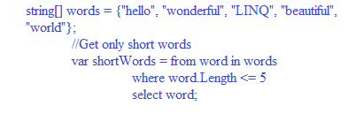
linq

Slide 3
Linq - syntax
Lamda (Method) Syntax
var longWords = words.Where( w => w.length > 10);
Query (Comprehension) Syntax
var longwords = from w in words where w.length > 10;

Slide 4
Linq - types
LINQ to Objects
LINQ to XML(XLINQ)
LINQ to DataSet
LINQ to SQL (DLINQ)
LINQ to Entities

Slide 5
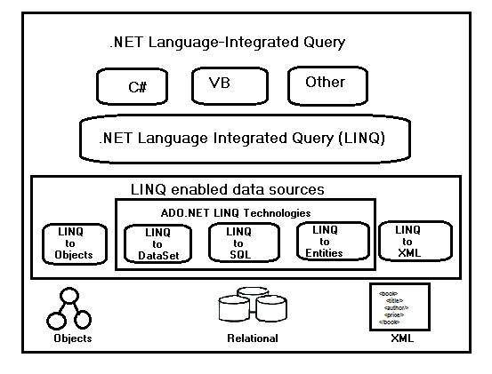
linq - architecture

Slide 6
Linq - advantages
LINQ offers IntelliSense which means writing more accurate queries easily.- also easily we can detect errors.
Writing codes is quite faster in LINQ and thus development time also gets reduced significantly
LINQ allows usage of a single LINQ syntax while querying many diverse data sources

Slide 7
LINQ - Query Operators
Filtering Operators
Join Operators
Projection Operations
Sorting Operators
Grouping Operators
Conversions
Concatenation
Aggregation
Quantifier Operations
Partition Operations
Generation Operations
Set Operations
Equality
Element Operators

Slide 8
Linq- Filtering Operators
Where - Filter values based on a predicate function
OfType - Filter values based on their ability to be as a specified type

Slide 9
Linq-projection operators
Select – projects values on basis of a transform function
Selectmany - project the sequences of values which are based on a transform function as well as flattens them into a single sequence

Slide 10
Linq – sorting operators
OrderBy - The operator sort values in an ascending order
OrderByDescending - The operator sort values in a descending order
ThenBy - Executes a secondary sorting in an ascending order
ThenByDescending - Executes a secondary sorting in a descending order
Reverse - Performs a reversal of the order of the elements in a collection

Slide 11
LINQ – GROUPING OPERATORS
GroupBy - Organize a sequence of items in groups and return them as an IEnumerable collection of type IGrouping<key, element>
ToLookup - Execute a grouping operation in which a sequence of key pairs are returned

Slide 12
Linq - conversions
AsEnumerable - Returns the input typed as IEnumerable<T>
AsQueryable - A (generic) IEnumerable is converted to a (generic) Iqueryable
Cast - Performs casting of elements of a collection to a specified type Use an explicitly typed range variable.
OfType - Filters values on basis of their , depending on their capability to be cast to a particular type
ToArray - Forces query execution and does conversion of a collection to an array
ToDictionary - On basis of a key selector function set elements into a Dictionary<TKey, TValue> and forces execution of a LINQ query
ToList - Forces execution of a query by converting a collection to a List<T> Not Applicable Not Applicable
ToLookup - Forces execution of a query and put elements into a Lookup<TKey, TElement> on basis of a key selector function Not Applicable

Slide 13
Linq - concatenation
Concat - Two sequences are concatenated for the formation of a single one sequence.

Slide 14
Linq - aggregation
Aggregate - Operates on the values of a collection to perform custom aggregation operation
Average - Average value of a collection of values is calculated
Count - Counts the elements satisfying a predicate function within collection
LonCount - Counts the elements satisfying a predicate function within a huge collection
Max - Find out the maximum value within a collection
Min - Find out the minimum value existing within a collection
Sum Find out the sum of a values within a collection

Slide 15
Linq – quantifier operators
All - Returns a value ‘True’ if all elements of a sequence satisfy a predicate condition
Any - Determines by searching a sequence that whether any element of the same satisfy a specified condition
Contains - Returns a ‘True’ value if finds that a specific element is there in a sequence if the sequence doe not contains that specific element , ‘false’ value is returned

Slide 16
Linq - Partition Operators
Skip - Skips some specified number of elements within a sequence and returns the remaining ones
SkipWhile - Same as that of Skip with the only exception that number of elements to skip are specified by a Boolean condition
Take - Take a specified number of elements from a sequence and skip the remaining ones
TakeWhile - Same as that of Take except the fact that number of elements to take are specified by a Boolean condition

Slide 17
Linq - Generation Operations
DefaultIfEmpty - When applied to an empty sequence, generate a default element within a sequence
Empty - Returns an empty sequence of values and is the most simplest generational operator
Range - Generates a collection having a sequence of integers or numbers
Repeat - Generates a sequence containing repeated values of a specific length

Slide 18
Linq – set operations
Distinct - Results a list of unique values from a collection by filtering duplicate data if any
Except - Compares the values of two collections and return the ones from one collection who are not in the other collection
Intersect - Returns the set of values found t be identical in two separate collections
Union - Combines content of two different collections into a single list that too without any duplicate content

Slide 19
Linq - equality
SequenceEqual - Results a Boolean value if two sequences are found to be identical to each other

Slide 20
Linq – element operators
ElementAt - Returns an element present within a specific index in a collection
ElementAtOrDefault - Same as ElementAt except of the fact that it also returns a default value in case the specific index is out of range
First - Retrieves the first element within a collection or the first element satisfying a specific condition
FirstOrDefault - Same as First except the fact that it also returns a default value in case there is no existence of such elements
Last - Retrieves the last element present in a collection or the last element satisfying a specific condition Not Applicable
LastOrDefault - Same as Last except the fact that it also returns a default value in case there is no existence of any such element
Single - Returns the lone element of a collection or the lone element that satisfy a certain condition
SingleOrDefault - Same as Single except that it also returns a default value if there is no existence of any such lone element
DefaultIfEmpty - Returns a default value if the collection or list is empty or null

Slide 21
Thank you

